Slide 1
Physiology and Disorders of URINARY SYSTEM
University of Basra
Collage of Science
Physiology
Dr. Hanaa Salman Kadhum

Slide 2
Urinary System Organs
Kidney
UuqUreter
Bladder
Urethra
System functions to remove waste products from the blood
Main functional units of the kidneys are the nephrons
Nephrons filter the blood and form the urine

Slide 3
The Urinary System
Paired kidneys
A ureter for each kidney
Urinary bladder
Urethra

Slide 4
Kidneys are retroperitoneal organs
Superior lumbar region of posterior abdominal wall
Lateral surface is convex
Medial surface is concave
Hilus* is cleft: vessels, ureters and nerves enter and leave
Adrenal glands* lie superior to each kidney
Kidney has two regions
Cortex: outer
Columns of cortex divide medulla into “pyramids”
Medulla: inner
Darker, cone-shaped medullary or renal pyramids
Parallel bundles of urine-collecting tubules

Slide 5
Main Functions of Urinary System
Kidneys filter blood to keep it pure
Toxins
Metabolic wastes
Excess water
Excess ions
Dispose of nitrogenous wastes from blood
Urea
Uric acid
Creatinine
Regulate the balance of water and electrolytes, acids and bases

Slide 6
The Kidneys (cont.)
Renal sinus – concave depression of the surface of the kidney
Hilum – point of entry for the renal artery, renal vein, and ureter
Renal pelvis – expansion of the ureter that further divides into calyces

Slide 7
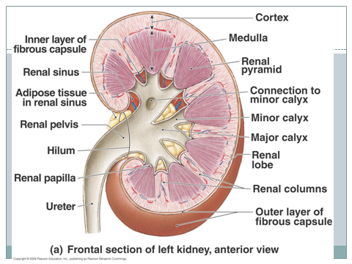

Slide 8
The Kidneys (cont.)
Renal cortex – outermost portion of the kidney that covers the pyramids and dips down between them
Renal medulla – middle portion that also divides into renal pyramids
Renal column – portion of the cortex between pyramids

Slide 9
The Kidneys: Nephrons
Removes waste products from the blood
Each kidney contains about 1 million nephrons
Made of a renal corpuscle and a renal tubule
Renal
Tubules
Renal
Corpuscles
Composed of a group of capillaries called a glomerulus
Glomerulus is surrounded by Bowman’s capsule
Blood filtration occurs in corpuscle

Slide 10
The Kidneys – Nephrons (cont.)
Blood Flow Through Nephron
Afferent Arteriole
Glomerulus
Afferent arterioles deliver blood to the glomeruli
Efferent arterioles carry blood from the glomeruli to peritubular capillaries
Efferent Arteriole
Peritubular Capillaries
Veins of the Kidney

Slide 11
The Arteries
Aorta gives off right and left renal arteries
Renal arteries divides into 5 segmental arteries as enters hilus of kidney
Segmentals branch into lobar arteries
Lobars divide into interlobars
Interlobars into arcuate in junction of medulla and cortex
Arcuates send interlobular arteries into cortex
Cortical radiate arteries give rise to glomerular arterioles

Slide 12
Vasculature of the kidney
The glomerular capillary bed is unusual in having arterioles going both to it and away from it (afferent and efferent), instead of a vein going away as most
It is also unusual in having two capillary beds in series (one following the other)

Slide 13
Urine Formation: Glomerular Filtration
First process occurs in renal corpuscles
Fluid part of the blood is forced from glomerulous into Bowman’s capsule
Becomes glomerular filtrate
To right is a single, generalized uriniferous tubule
More than a million of these tubules act together to form the urine
Two major parts
A urine-forming nephron
A collecting duct which concentrates urine by removing water from it

Slide 14
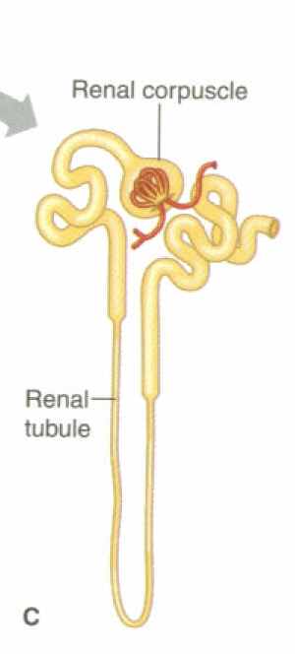
Urine Formation: Glomerular Filtration (cont.)
Factors affecting glomerular filtration
Filtration pressure – amount of pressure that forces filtrate from the glomerulus into Bowman’s capsule.
Determined by blood pressure
Rate of filtration – sympathetic nervous system control
Constriction of afferent arterioles decreases filtration pressure

Slide 15
Urine Formation: Tubular Reabsorption
Second process in urine formation
Blood reabsorbs needed substances from the proximal convoluted tubule
Glomerular filtrate → proximal convoluted tubule
Nutrients, water, and ions pass through the walls of the renal tubule into the peritubular capillaries
Water reabsorption depends on hormones
Antidiuretic hormone (ADH)
Aldosterone
Both increase water reabsorption, which decreases urine production

Slide 16
Urine Formation: Tubular Secretion
Third process of urine formation
Substances move from blood in the peritubular capillaries into the renal tubules
Secreted substances
Drugs
Hydrogen ions
Waste products

Slide 17
Urine Formation (cont.)
Urine composition
Mostly water
Urea and uric acid
Formed by the breakdown of proteins and nucleic acids
Trace amounts of amino acids and various ions
Secretion of waste products helps maintain the acid-base balance

Slide 18
Ureters, Urinary Bladder, and Urethra
The Ureters
Long muscular tubes
Carry urine to the bladder
Peristalsis – rhythmic muscular contraction of ureters
Slender tubes about 25 cm (10 “) long leaving each renal pelvis
One for each kidney carrying urine to the bladder
This oblique entry helps prevent backflow of urine

Slide 19
Ureters, Urinary Bladder, and Urethra (cont.)
Urinary bladder
Expandable muscular organ
Stores up to 600 ml urine on average
Stores and expels urine
Lies on pelvic floor posterior to pubic symphysis
Males: anterior to rectum
Females: just anterior to the vagina and uterus
Detrusor muscle – smooth muscle in wall of bladder
Trigone – triangle on internal floor of bladder formed by urethra and ureters
Micturation
Process of urination
Stretching of bladder triggers process
Approximately 150cc of urine

Slide 20
Ureters, Urinary Bladder, and Urethra (cont.)
Urethra
Tube that moves urine from the bladder to the outside world
Smooth muscle with inner mucosa
Changes from transitional through stages to stratified squamous near end
Drains urine out of the bladder and body
Male: about 20 cm (8”) long
Female: 3-4 cm (1.5”) long
Short length is why females have more urinary tract infections than males - ascending bacteria from stool contamination

Slide 21
Diseases and Disorders of the Urinary System
Disease/Disorder | Description
Acute renal failure | Sudden loss of kidney function; may be reversible with treatment
Chronic renal failure | Kidneys slowly use ability to function; not reversible
Cystitis | Urinary bladder infection; more common in females
Glomerulonephritis | Inflammation of the glomeruli of the kidney; one cause of chronic renal failure
Incontinence | Inability to control urination

Slide 22
Diseases and Disorders of the Urinary System
Disease/Disorder | Description
Polycystic kidney disease | Enlargement of kidneys because of the presence of many cysts within them; slow, progressive disease
Pyelonephritis | Complicated urinary tract infection; starts with a bladder infection and spreads to both kidneys; can be acute or chronic
Renal calculi | Kidney stones; can become lodged in ducts within kidneys or ureters

Slide 23
Breaching Homeostasis
1. Diabetic Kidney Disease
If glucose stays in the blood instead of breaking down, it can act like a poison, damaging the nephrons.
2. High Blood Pressure
-can damage the small blood vessels in the kidneys so they can’t filter wastes.
3. Glomerular Diseases
-attack the tiny blood vessels, glomeruli, within the kidney.
The first sign of a glomerular disease is often too much protein in the urine. Another common sign is blood in the urine. Glomerular diseases can slowly destroy kidney function.

Slide 24
Breaching Homeostasis
4. Inherited and Congenital Kidney Diseases
Example: Polycystic kidney disease (PKD), for example, is a genetic disorder in which many cysts grow in the kidneys.
5. Trauma, such as a direct and forceful blow to the kidneys, can lead to kidney disease
6. Ingestions of poisons.

Slide 25
What happens when kidneys fail completely?
The body fills with extra water and waste products (uremia). Hands or feet may swell. A person will feel tired and weak because the body needs clean blood to function properly.
2. Untreated uremia may lead to seizures or coma and will ultimately result in death.
3. A person whose kidneys stop working completely will need to undergo dialysis or kidney transplantation.

